Slide 1

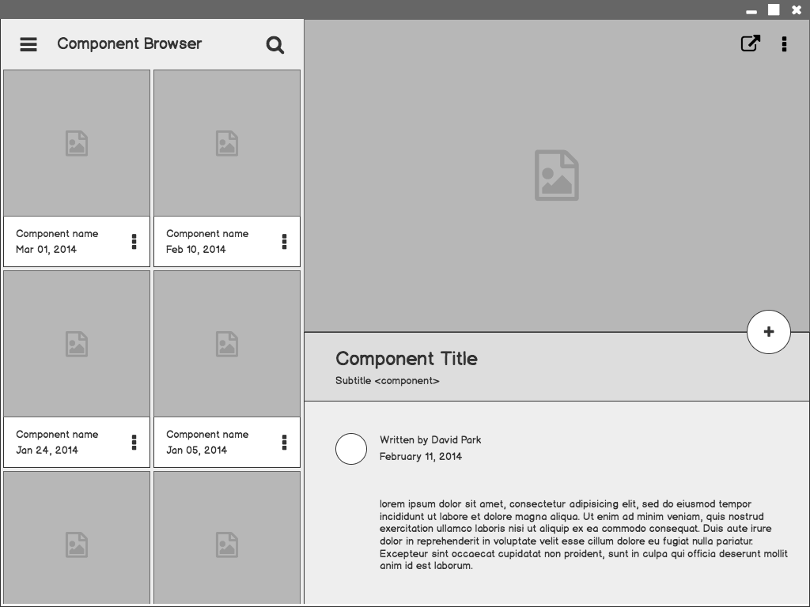


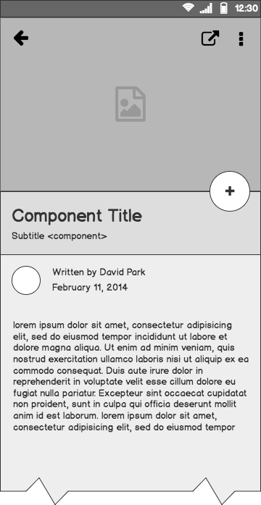
John the Ripper
A password cracking tool

Slide 2
John the Ripper
-Powerful open-source password cracking software tool
-Widely used in Penetration testing cybersecurity.
-Crack password hashes
→ check password strength
→ identify weak credentials
-Hash types supported.

Slide 3
Working:
Brute Force attack
-Tries every possible combination of characters
- Time consuming but guarantee result when password is short.
Dictionary Attack
Uses wordlist to compare common passwords against the hash.
Fast and effective for weak or reused password.

Slide 4
Rule-based attack
Apply transformation rules to dictionary words.
Great for cracking passwords with slight variations.
Incremental Mode
Most powerful mode
Uses all character combinations intelligently based on frequency and pattern.
External Mode
Allows custom cracking logic via scripting, offering flexibility for advanced users.

Slide 5
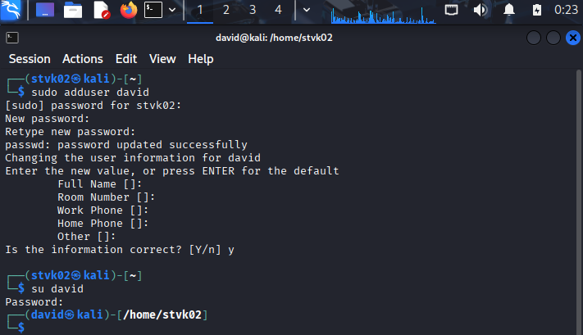
Dictionary Attack Implementation

Slide 6
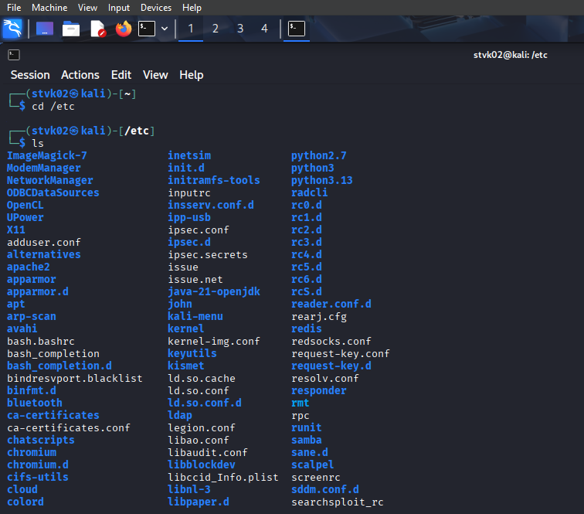

Slide 7
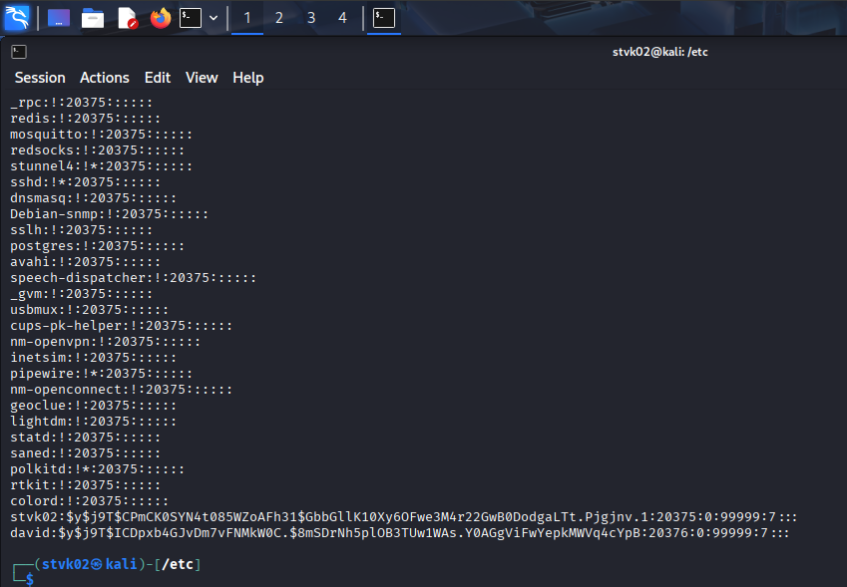
Finding shadow file and getting its contents

Slide 8
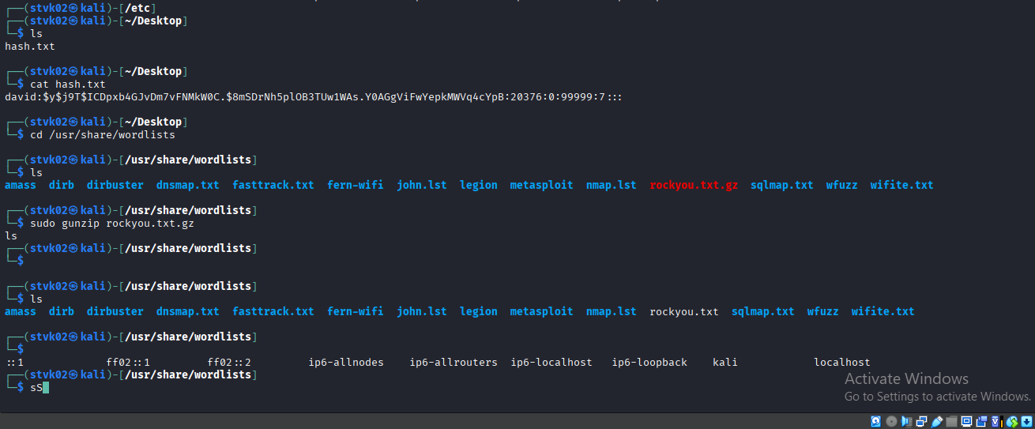

Slide 9
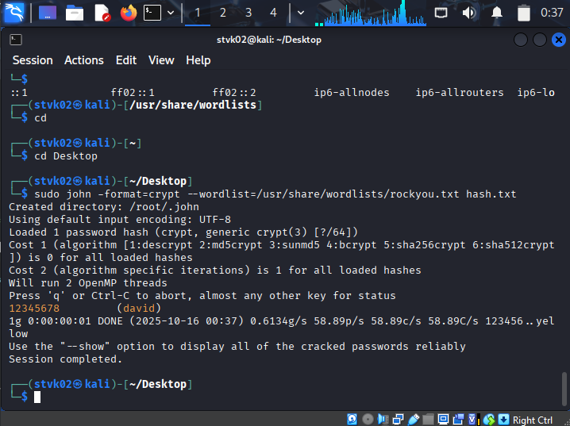
Find a wordlist file→
A file with millions of hash passwords.
Rockyou.txt → a file in kali linux
Using this file, JtR cracks the password for the account.

Slide 10
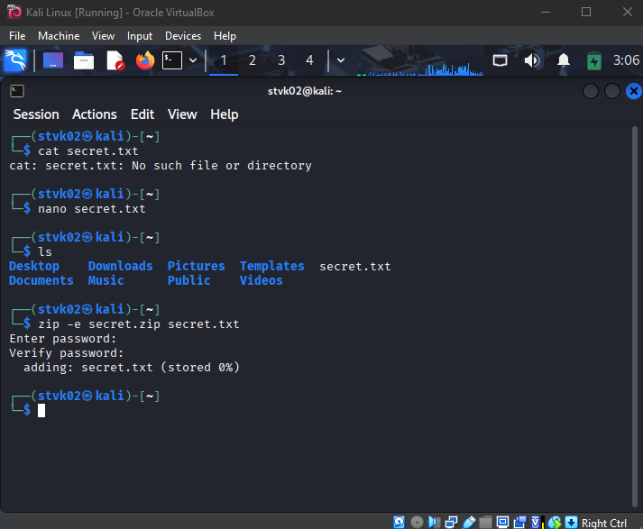
What if there’s a locked zipped file?
JtR can also crack the password for the zipped file.

Slide 11
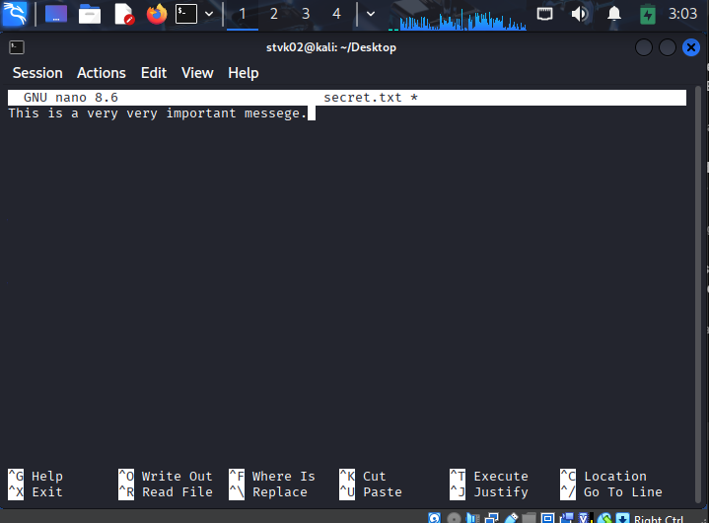

Slide 12
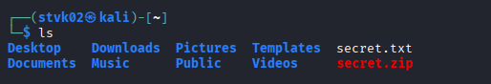
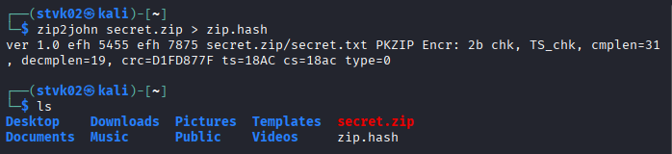
We create a file and zip it. Then we remove the text file and all there is left is zip file. We then create a hash file for the zip file. We take a file with many passwords in it and use JtR to find the lost password for the zip file.

Slide 13
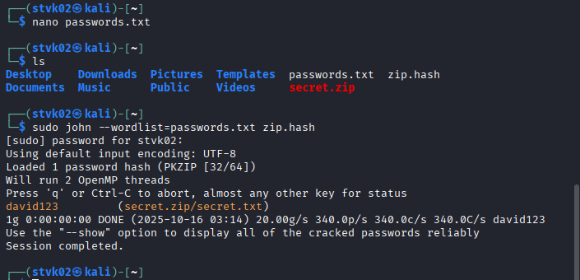

Slide 14
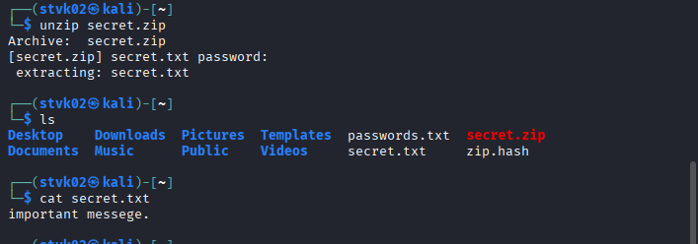
By using JtR, we are able to crack the password and get the contents of the zip file.

